Slide 1
MSc Project Recommender Systems: looking further into the future
Meeting: 20/06/2023

Slide 2
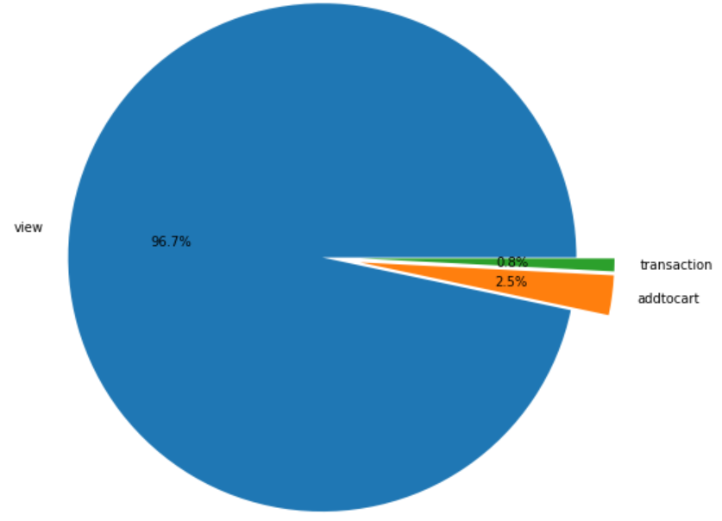
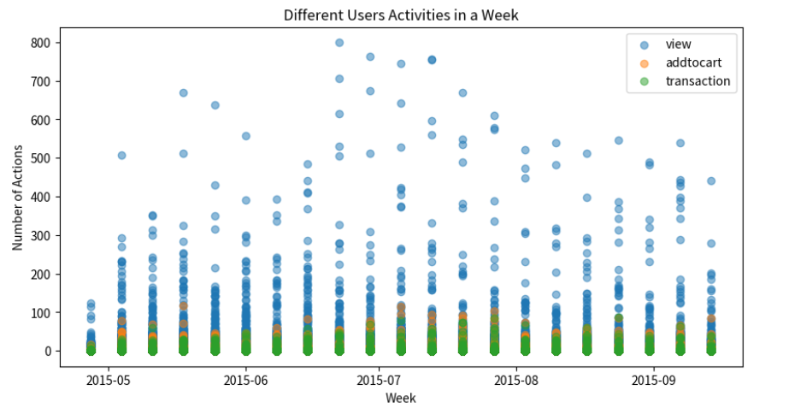
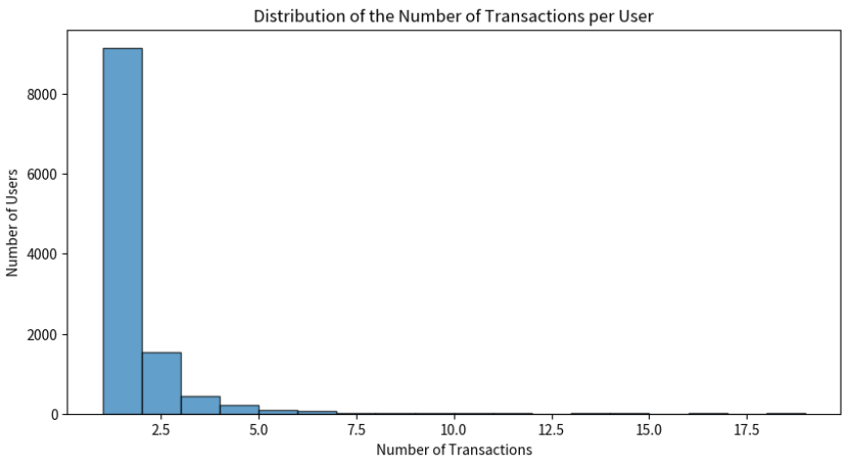
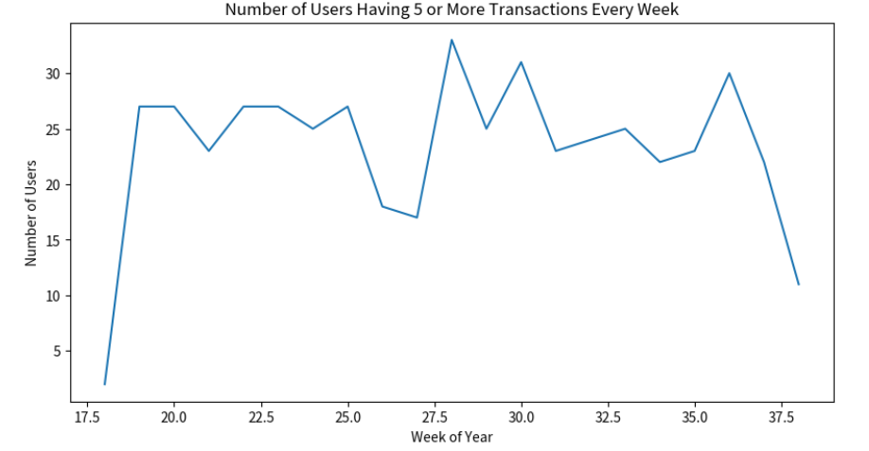
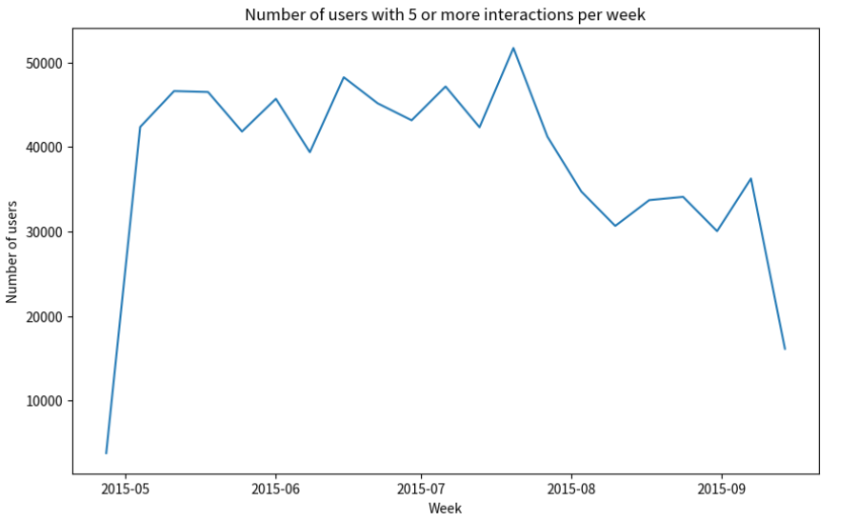
EDA on Retail Rocket:
Number of unique users: 1407580
Event distribution:
Views: 2664312
Add to cart: 69332
Transactions: 22457
Transactions Event Analysis:
Total number of transaction: 22457
Average transactions per user: 1.916289
Average sequence length in days for each user: 1.045140370338766
Average number of 7-day windows per user: 0.13234917655090025
Minimum number of 7-day windows per user: 0
Maximum number of 7-day windows per user: 18
Number of users with only one 7-day window: 69
Number of users having 5 or more transactions within a week (any week): 489

Slide 3
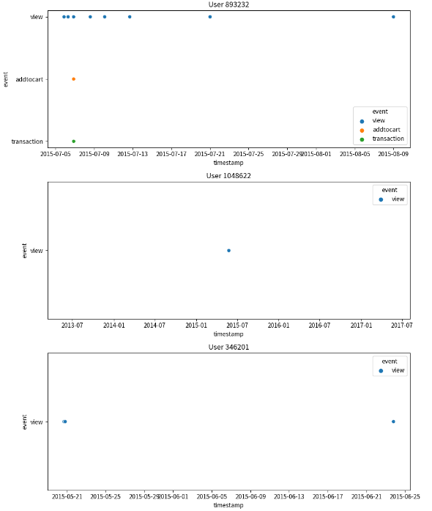
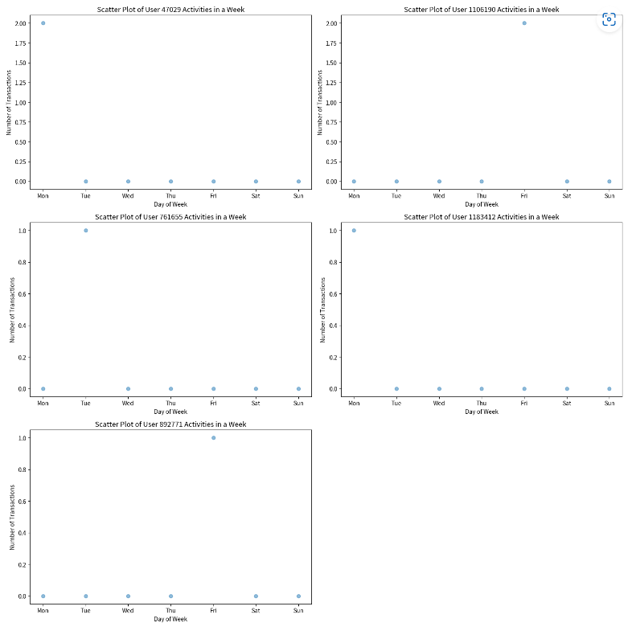
EDA on Retail Rocket:

Slide 4
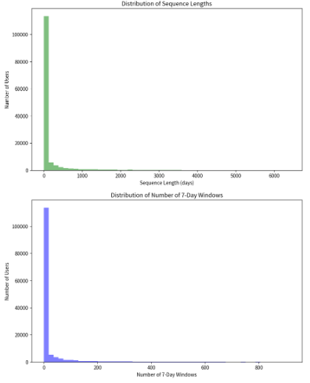
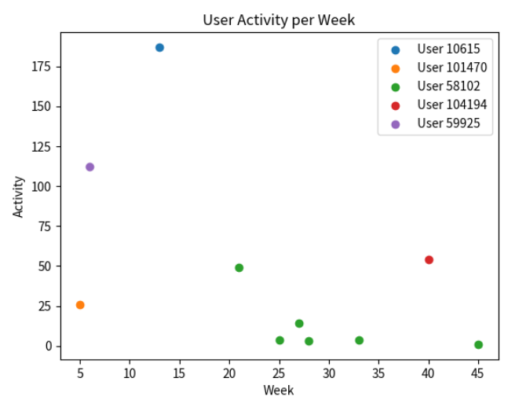
EDA on ML-20M:
Number of unique users: 138493
Number of unique movies: 26744
Number of ratings: 20000263
Action Analysis:
Average sequence length in days for each user: 196.3789577812
Average number of 7-day windows per user: 27.900420959
Minimum number of 7-day windows per user: 0
Maximum number of 7-day windows per user: 915
Number of users with only one 7-day window: 3519
Average number of 7-day windows per user where user was active at least 5 different days in the week: 0.2774219635649
Number of users who have interacted in 5 days within a week: 4875

Slide 5

Evaluation Metrics:
Kendall’s τ:
Look at position p, which contains the item i. Then create pairs (p_i = r_i), where r_i is the rank of item i in the recommendation list. Calculate τ:
Example:
True Order: Superman, Batman, Iron Man
Predicted Order: Batman, Superman, Iron Man
We represent this as pairs of (position, ranking):
For Superman: True position: 1 Predicted ranking: 2 (as it's second in the predicted list)
For Batman: True position: 2 Predicted ranking: 1 (as it's first in the predicted list)
For Iron Man: True position: 3 Predicted ranking: 3 (as it's third in the predicted list)
So, the true positions are (1, 2, 3) and the predicted rankings are (2, 1, 3). Then calculate Kendall’s τ based on the two lists.
Poor results as we create predicted ranking based on just top-1 rank (very difficult).

Slide 6
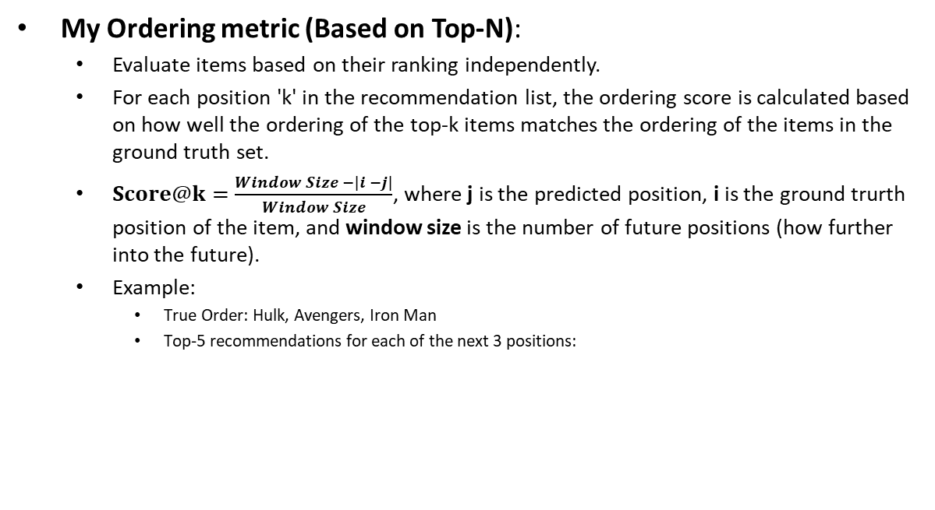
Evaluation Metrics:
My Ordering metric (Based on Top-N):
Evaluate items based on their ranking independently.
For each position 'k' in the recommendation list, the ordering score is calculated based on how well the ordering of the top-k items matches the ordering of the items in the ground truth set.
$Score@k=\frac{Window Size −|i −j|}{Window Size}$, where j is the predicted position, i is the ground trurth position of the item, and window size is the number of future positions (how further into the future).
Example:
True Order: Hulk, Avengers, Iron Man
Top-5 recommendations for each of the next 3 positions:
Position | Rec. 1 | Rec. 2 | Rec. 3 | Rec. 4 | Rec. 5
1 | Hulk | Thor | Avengers | Iron Man | Captain America
2 | Thor | Iron Man | Captain America | Avengers | Hulk
3 | Avengers | Iron Man | Captain America | Thor | Hulk

Slide 7
Evaluation Metrics:
My Ordering metric (Based on Top-N):
Example:
True Order: Hulk, Avengers, Iron Man
Top-5 recommendations for each of the next 3 positions into the future:
For position 1:
Hit Rate = 1 (Hulk in top-5)
Order Score = (3 – abs(0-0)) / 3 = 3/3 = 1 (correct position in top-5)
For position 2:
Hit Rate = 1 (Avengers in top-5)
Order Score = (3 – abs(1-3)) / 3 = 1/3 = 0.33 (should have been at the 2nd position but it's at the 4th in the recommendations)
For position 3:
Hit Rate = 1 (Iron Man in top-5)
Order Score = (3 – abs(2-1)) / 3 = 2/3 = 0.66
Average Hit Rate = (1 + 1 + 1) / 3 = 3/3 = 1
Average Order Score = (1 + 0.33 + 0.66) / 3 ≈ 2/3 = 0.66
Position | Rec. 1 | Rec. 2 | Rec. 3 | Rec. 4 | Rec. 5
1 | Hulk | Thor | Avengers | Iron Man | Captain America
2 | Thor | Iron Man | Captain America | Avengers | Hulk
3 | Avengers | Iron Man | Captain America | Thor | Hulk

Slide 8
Experiments:
Baseline – SASRec next-item training:
NDCG@10 Test Average: 0.5246
HR@10 Test Average: 0.8069
Order Score@10 Test Average: 0.5256
Kendall's Tau Average: 0.1443
Position | NDCG | HR | Order Score
1 | 0.6054 | 0.8745 | 0.6473
2 | 0.5750 | 0.8480 | 0.6482
3 | 0.5530 | 0.8347 | 0.6145
4 | 0.5207 | 0.8087 | 0.5500
5 | 0.4943 | 0.7748 | 0.4757
6 | 0.4686 | 0.7626 | 0.4125
7 | 0.4550 | 0.7446 | 0.3308

Slide 9
Experiments:
SASRec next-item training – independent feeding:
Create training seq. based on target window. E.g. target [5,6]:
[1, 2, 3, 4, 5]
[1, 2, 3, 4, 6]
NDCG@10 Test Average: 0.5025
HR@10 Test Average: 0.7887
Order Score@10 Test Average: 0.5076
Kendall's Tau Average: 0.1106
Position | NDCG | HR | Order Score
1 | 0.5633 | 0.8428 | 0.6023
2 | 0.5442 | 0.8276 | 0.6159
3 | 0.5275 | 0.8119 | 0.5878
4 | 0.4982 | 0.7920 | 0.5393
5 | 0.4776 | 0.7633 | 0.4741
6 | 0.4622 | 0.7483 | 0.4044
7 | 0.4446 | 0.7351 | 0.3292

Slide 10
Experiments:
SASRec all-action train – Baseline:
NDCG@10 Test Average: 0.2246
HR@10 Test Average: 0.4070
Order Score@10 Test Average: 0.2471
Kendall's Tau Test Average: 0.0459
Position | NDCG | HR | Order Score
1 | 0.2572 | 0.4456 | 0.2442
2 | 0.2401 | 0.4271 | 0.2675
3 | 0.2315 | 0.4150 | 0.2736
4 | 0.2220 | 0.4026 | 0.2613
5 | 0.2212 | 0.3993 | 0.2519
6 | 0.2055 | 0.3852 | 0.2288
7 | 0.1950 | 0.3739 | 0.2026

Slide 11
Experiments:
SASRec all-action train – independent feeding:
NDCG@10 Test Average: 0.4031
HR@10 Test Average: 0.6743
Order Score@10 Test Average: 0.4268
Kendall's Tau Average: 0.0851
Position | NDCG | HR | Order Score
1 | 0.4508 | 0.7286 | 0.4694
2 | 0.4373 | 0.7058 | 0.4969
3 | 0.4141 | 0.6879 | 0.4840
4 | 0.4040 | 0.6814 | 0.4634
5 | 0.3867 | 0.6480 | 0.4038
6 | 0.3696 | 0.6413 | 0.3655
7 | 0.3593 | 0.6274 | 0.3049

Slide 12
Future:
Start thinking about temporal information.
Teacher-forcing approach?
[1,2,3,4,5] target is 5
Then [1,2,3,4,5(ground truth),6] target is 6
Autoregressive approach?
[1,2,3,4,5] target is 5
[1,2,3,4,5(predicted), 6] target is 6
Dense All Action.
Think about loss change to make multiple target predictions.

